Slide 1
The Robotarium: A Remotely Accessible Swarm Robotics Research Testbed
Magnus Egerstedt

Slide 2
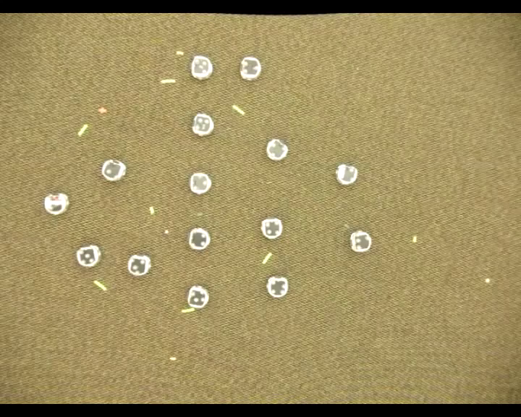

What’s Missing In This Picture?

Slide 3
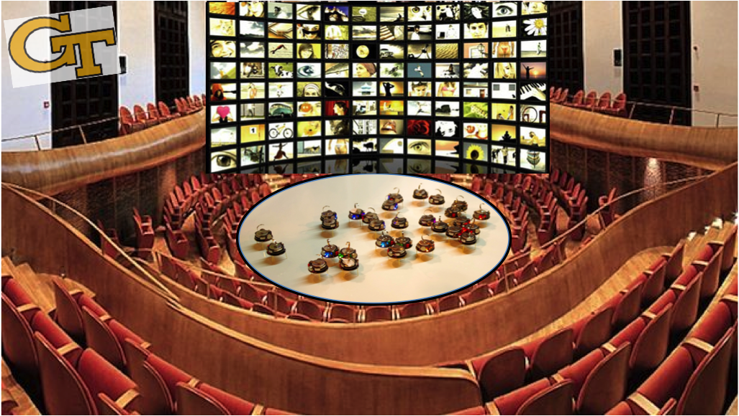

The Robotarium
Overarching Vision: An open, remote-access swarm-robotics testbed!
MRI: A Shared, Remote-Access Multi-Robot Laboratory

Slide 4
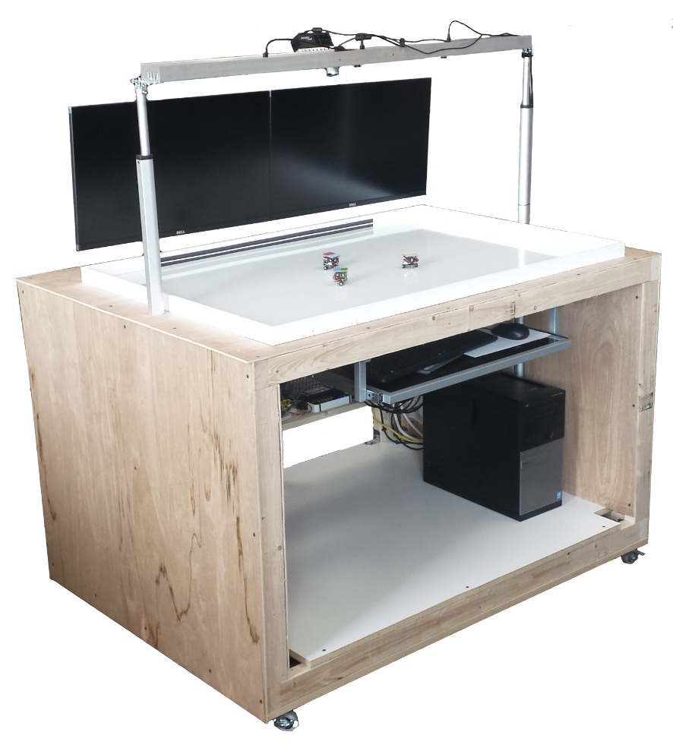
Robotarium 1.0
Pickem, Glotfelter, Wang, Mote, Ames, Feron, Egerstedt, ICRA’17

Slide 5
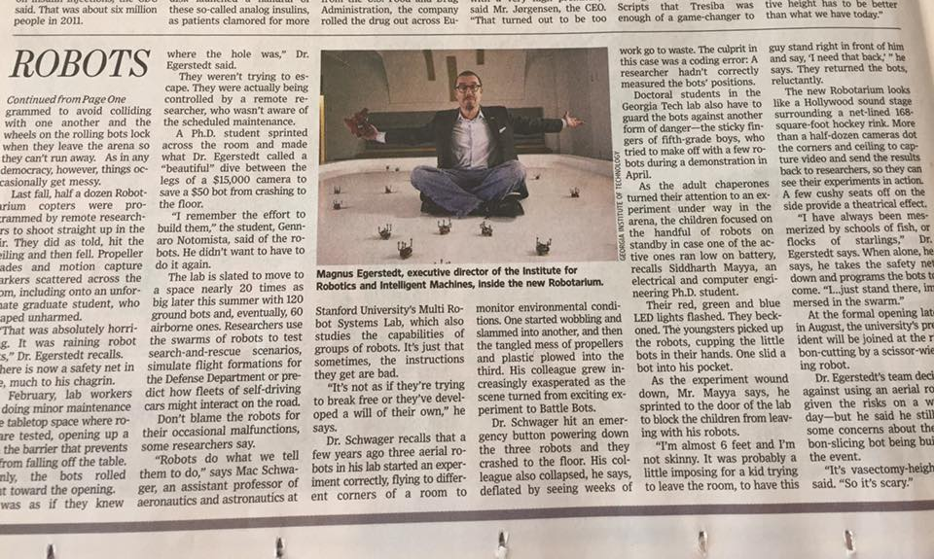
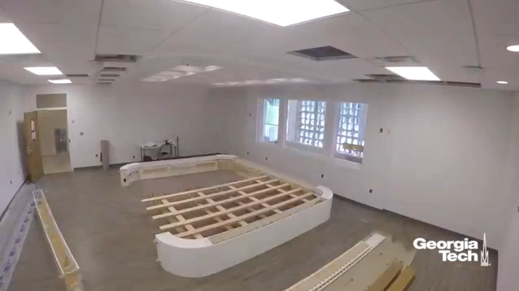
Robotarium 2.0

Slide 6




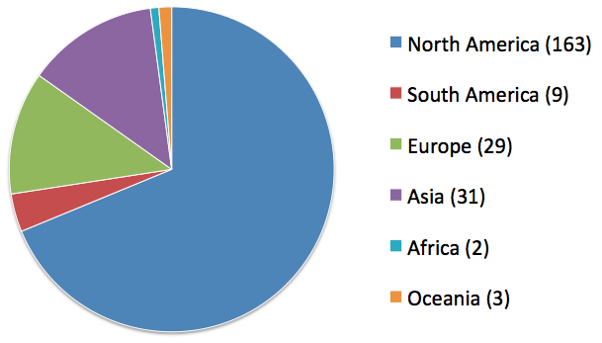
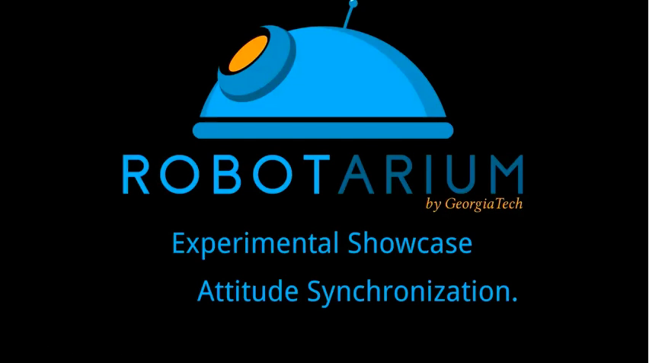



So Far… [www.robotarium.org]
Distributed Formation Control
Fault-Tolerant Rendezvous
K. Fathian, N. Gans, M. Spong
H. Park, S. Hutchinson
Since Aug. 2017:
120 robots, 237 research groups, 200+ student projects
Attitude Synchronization
J. Yamauchi, M. Fujita

